Slide 1

Integrating React with Web API
Tutorial

Slide 2
Agenda
Review API Design
Develop front end API Module
Endpoint
Routes
React Authentication Context
React Login/Registration Page

Slide 3
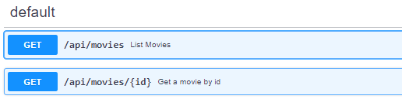
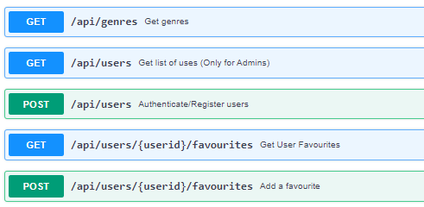
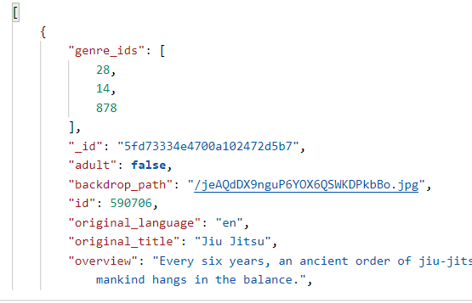
Review API Design
Fully understand the API
Examine Routes
Examine Request & Response Requirements
Body (e.g. properties)
Format (e.g. json)
Examine Authentication
JWT/Sessions
TEST WITH POSTMAN
Even better, write unit tests!

Slide 4
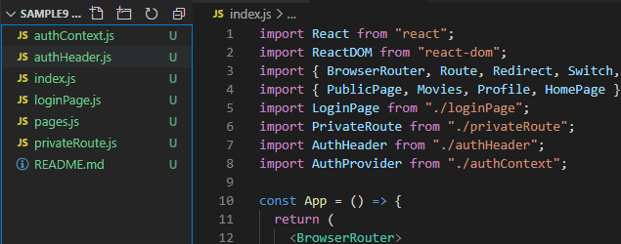
Design React App
This can be your Movies App from assignment 1
Use stub API/TMDB up to now
Don’t forget authentication(login/register) pages and routes

Slide 5
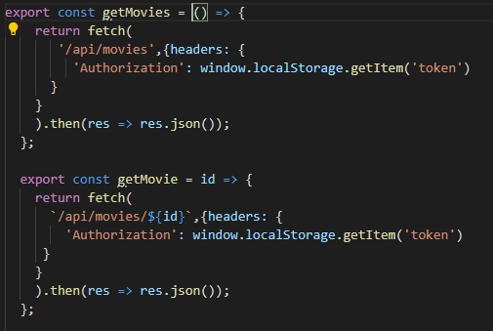
Write API Module
Abstract API calls to exported functions.

Slide 6
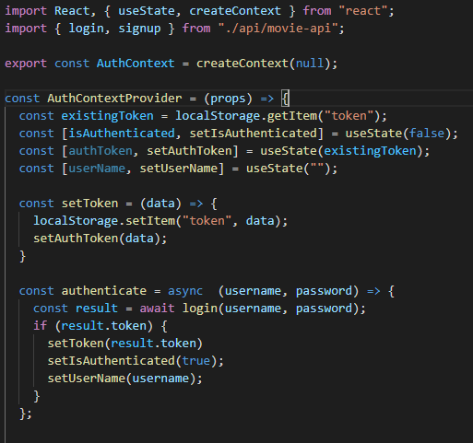
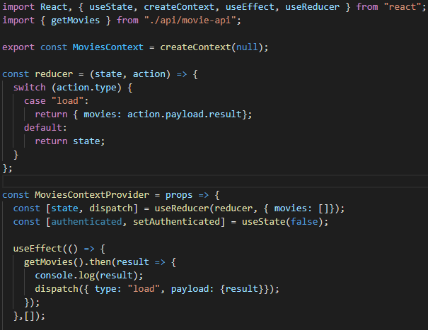
Design/Refactor React Contexts to access API
AuthContext, Movies Context:

Slide 7
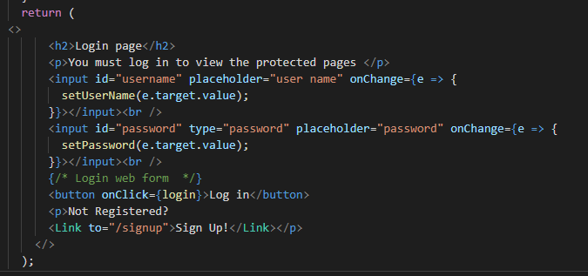
Update pages to use Contexts
Login Page:

